Slide 1

Unit-2 Project Integration Management
Project Management Tools (PMT)
2305CS322
Prof. Mayur Padia
Computer Engineering Department
mayur.padia@darshan.ac.in
99255 15118

Slide 2
Outline
Introduction to Project Integration Management
Strategic Planning and Project Selection
Methods of Selecting Projects
Developing a Project Charter
Developing a Project Management Plan
Monitoring and Controlling a Project Work
Performing Integrated Change Control
Key Terms
Quiz

Slide 3
Introduction to Project Integration Management
Section - 1

Slide 4
Project Integration Management
Project Integration Management involves coordinating all of the other project management knowledge areas throughout a project’s life cycle.
It ensures that all the elements of a project come together at the right times to complete a project successfully.
According to the PMBOK® Guide, six main processes involved in project integration management are:
Developing the project charter involves working with stakeholders to create the document that formally authorizes a project—the charter.
Developing the project management plan involves coordinating all planning efforts to create a consistent, coherent document—the project management plan.
Directing and managing project work involves carrying out the project management plan by performing the activities.
Monitoring and controlling project work involves overseeing activities to meet the performance objectives of the project.

Slide 5
Project Integration Management (contd.)
Performing integrated change control involves identifying, evaluating, and managing changes throughout the project life cycle.
The outputs of the processes from 3-5 are deliverables, work performance information, change requests, project management plan updates, and project documents updates.
Closing the project or phase involves finalizing all activities to formally close the project or phase.
Outputs of this process include final product, service, or result transition and organizational process assets updates.
Someone must take responsibility for coordinating all of the people, plans, and work required to complete a project.
Someone must focus on the big picture of the project and steer the project team toward successful completion.
Someone must make the final decisions when conflicts occur among project goals or people.
Someone must communicate key project information to top management.
The responsibilities belong to the project manager, whose chief means for accomplishing all these tasks is project integration management.

Slide 6
Project Integration Management (contd.)
It is important to understand the organization’s needs and staff your project with skilled workers capable of making the project a success. Good project integration management is critical to providing stakeholder satisfaction.
Project integration management includes interface management, which involves identifying and managing the points of interaction between various elements of a project. The primary tools for interface management are communication and relationships.
The number of interfaces can increase exponentially as the number of people involved in a project increases.
The project manager must communicate well with all project stakeholders, including customers, the project team, top management, other project managers, and opponents of the project.
Project managers must always view their projects in the context of the changing needs of their organizations and respond to requests from top management.
Top management must keep project managers informed of major issues that could affect their projects.

Slide 7
Strategic Planning and Project Selection
Section - 2

Slide 8
Strategic Planning and Project Selection
Strategic planning involves determining long-term objectives by
Analyzing the strengths and weaknesses of an organization
Studying opportunities and threats in the business environment
Predicting future trends
Projecting the need for new products and services
It provides important information to help organizations identify and then select potential projects.
SWOT analysis helps to identify potential projects.

Slide 9
SWOT Analysis
SWOT (strengths, weaknesses, opportunities, and threats) analysis is a framework
It is used to evaluate a company's competitive position and to develop strategic planning.
It helps identify internal factors (strengths and weaknesses) and external factors (opportunities and threats) that can impact success.
By analyzing these factors, organizations can make informed decisions, take advantage of opportunities, and lessen potential risks.
A SWOT analysis is designed to facilitate a realistic, fact-based, data-driven look at the strengths and weaknesses of an organization.

Slide 10
SWOT Analysis
Strengths describe what an organization excels at and what separates it from the competition: a strong brand, loyal customer base, a strong balance sheet, unique technology, and so on.
Weaknesses stop an organization from performing at its optimum level. They are areas where the business needs to improve to remain competitive: a weak brand, higher-than-average turnover, high levels of debt, an inadequate supply chain, or lack of capital.
Opportunities refer to favorable external factors that could give an organization a competitive advantage: if a country cuts tariffs, a car manufacturer can export its cars into a new market, increasing sales and market share.
Threats refer to factors that have the potential to harm an organization: a drought is a threat to a wheat-producing company, as it may destroy or reduce the crop yield.
Example 1
Example 2
Example 3

Slide 11





SWOT Analysis
STRENGTHS
WEAKNESSES
Strong sales and interpersonal skills
No financial or accounting experience
Strong technical skills
No marketing strategy
Number of completed projects
Little money to invest
OPPORTUNITIES
THREATS
Opportunity to bid on large projects
Someone might provide same service
Ways to promote company
How are consumer trends changing
What new segments can we test?
What are competitors doing?
PitchSpot

Slide 12
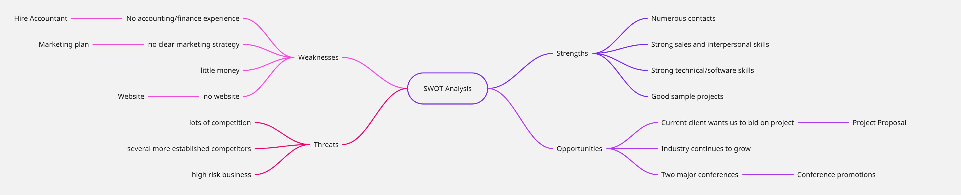
Mind Map of a SWOT Analysis - Example

Slide 13
Identifying Potential Projects
Project initiation starts with identifying potential projects, using realistic methods to select which projects to work on
It then formalize the initiation by issuing some sort of project charter.
In addition to using a SWOT analysis, organizations often follow a four-stage process for selecting IT projects.
IT strategic plan: A steering committee develops an IT strategic plan that is tied to the organization’s overall strategic plan.
The steering committee consists of managers from departments throughout the company to ensure that all projects are selected in the best interests of the entire organization.
The head of the Project Management Office (PMO) would be part of this committee.
It is very important to have managers from outside the IT department assist in developing the IT strategic plan, as they can help IT personnel understand organizational strategies and identify the business areas that support them.

Slide 14


Identifying Potential Projects (contd.)
Business Area Analysis: It outlines business processes that are central to achieving strategic goals and helps determine which processes could most benefit from IT. It helps to identify
Which processes are core to the organization’s strategic goals?
Which areas are experiencing inefficiencies, delays, or errors?
Project Planning: The organization then starts defining the scope, benefits, and constraints of potential IT projects.
Resource Allocation: Choose which projects to do and assigning resources for working on them.
Case Study:

Slide 15
Planning Process for Selecting IT Projects
IT Planning Stages
Results Produced
IT Strategy Planning
Tie information technology strategy to mission and vision of organization. Identify key business areas.
Business Area Analysis
Document key business processes that could benefit from information technology.
Define potential projects. Define project scope, benefits, and constraints.
Project Planning
Finalizing projects. Assign resources.
Resource Allocation

Slide 16
Methods of Selecting Projects
Section - 3

Slide 17
Technique for Selecting Projects
Focusing on broad organizational needs
Categorizing IT projects
Performing net present value or other financial analyses
Using a weighted scoring model
Implementing a balanced scorecard

Slide 18
Focusing on broad organizational needs
Managers must focus on meeting organizations needs when deciding what projects to undertake, when to undertake them, and to what level.
E.g., organizational need might be to improve safety, increase morale, provide better communications, or improve customer service.
Another method for selecting projects based on needs is, to determine whether they first meet three criteria: need, funding, and will.
Do people in organization agree that the project needs to be done?
Does the organization have the desire and capacity to provide adequate funds to perform the project?
Is there a strong will to make the project succeed?
The organization must reevaluate the need, funding, and will for each project to determine if it should be continued, redefined, or terminated.
OKRs by John Doerr | TED

Slide 19


Slide 20
Categorizing IT Projects
Another method for selecting projects, is based on various categorizations, such as
Project’s impetus – It often respond to a problem, an opportunity, or a directive
Problems are undesirable situations that prevent an organization from achieving its goals. It can be current or expected. – E.g., a project to enhance the current system by adding more access lines or upgrading the hardware with a faster processor, more memory, or more storage space.
Opportunities are chances to improve the organization. E.g., launching a new product
Directives are new requirements imposed by management, government, or some external influence. – E.g., projects that involve medical technologies must meet rigorous government requirements
Time window
How long will it take to complete a project and what is the deadline for completing it?
General priority
Organizations can also categorize IT projects as having high, medium, or low priority based on the current business environment.

Slide 21
Time Value of Money
The Time Value of Money (TVM) states that a specific amount of money today is worth more than the same amount in the future due to its potential earning capacity.
Key Principle:
Money can earn interest over time.
Receiving ₹1000 today is better than receiving ₹1000 next year.
Formula (Future Value):
𝐹𝑉 = 𝑃𝑉 × (1+𝑟)^{𝑛}
Where:
𝐹𝑉: Future Value
𝑃𝑉: Present Value
𝑟: Interest Rate
𝑛: Number of periods
Example 1 – Future Value:
You invest ₹10,000 today at 8% annual interest for 2 years:
𝐹𝑉=10,000×(1+0.08)² = ₹11,664
₹10,000 today grows to ₹11,664 in 2 years

Slide 22
Performing Financial Analyses
Three primary methods for projecting the financial value of projects include
Net Present Value Analysis (NPV)
Return on Investment (ROI), and
Payback Analysis

Slide 23
Net Present Value Analysis
Net present value (NPV) analysis is a method of calculating the expected net monetary gain or loss from a project
Here we calculate the value of all expected future cash inflows and outflows at the present time.
A positive NPV means that the return from a project exceeds the cost of capital.
To calculate NPV, you must assume a certain discount rate.
The discount rate is the interest rate used to discount cash flows.
It takes into account time value of money, risk or uncertainty of future cash flows.
The greater the uncertainty of future cash flows, the higher the discount rate.
It is also called the capitalization rate or the opportunity cost of capital.

Slide 24
Example of Net Present Value
Benefits minus Costs or
Income minus Expenses
NPV Function in Excel

Slide 25
Steps to Determine NPV
Determine the estimated costs and benefits for the life of the project and the products it creates.
Determine the discount rate. Financial experts can tell you what discount rate to use.
Calculate the net present value. Most spreadsheet software has a built-in function to calculate NPV.
For example, the formula that Microsoft Excel uses: =npv(discount rate, range of cash flows)
To use the NPV function, you must have a row or column in the spreadsheet for the cash flow each year, which is the benefit amount for that year minus the cost amount.

Slide 26
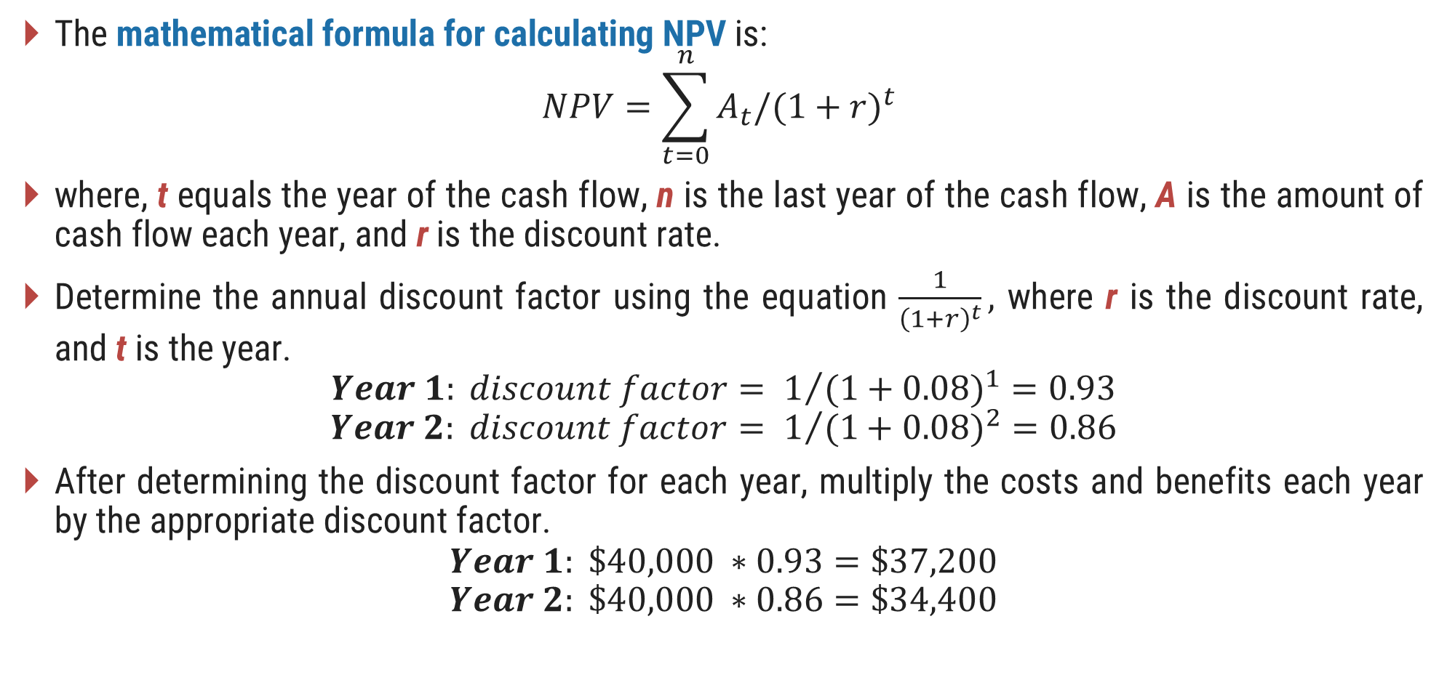
Mathematical Formula for Calculating NPV
The mathematical formula for calculating NPV is:
$$NPV=\sum_{t=0}^{n}{A_{t}/{(1+r)}^{t} }$$
where, t equals the year of the cash flow, n is the last year of the cash flow, A is the amount of cash flow each year, and r is the discount rate.
Determine the annual discount factor using the equation $\frac{1}{{\left(1+r\right)}^{t}},$ where r is the discount rate, and t is the year.
$$Year 1: discount factor= 1/{{(1+0.08)}^{1}}=0.93$$
$$Year 2: discount factor= 1/{{(1+0.08)}^{2}}=0.86$$
After determining the discount factor for each year, multiply the costs and benefits each year by the appropriate discount factor.
$$Year 1: \$40,000 ∗0.93=\$37,200$$
$$Year 2: \$40,000 ∗0.86=\$34,400$$

Slide 27
Net Present Value and Return on Investment Example
NPV
Payback in Year 1

Slide 28
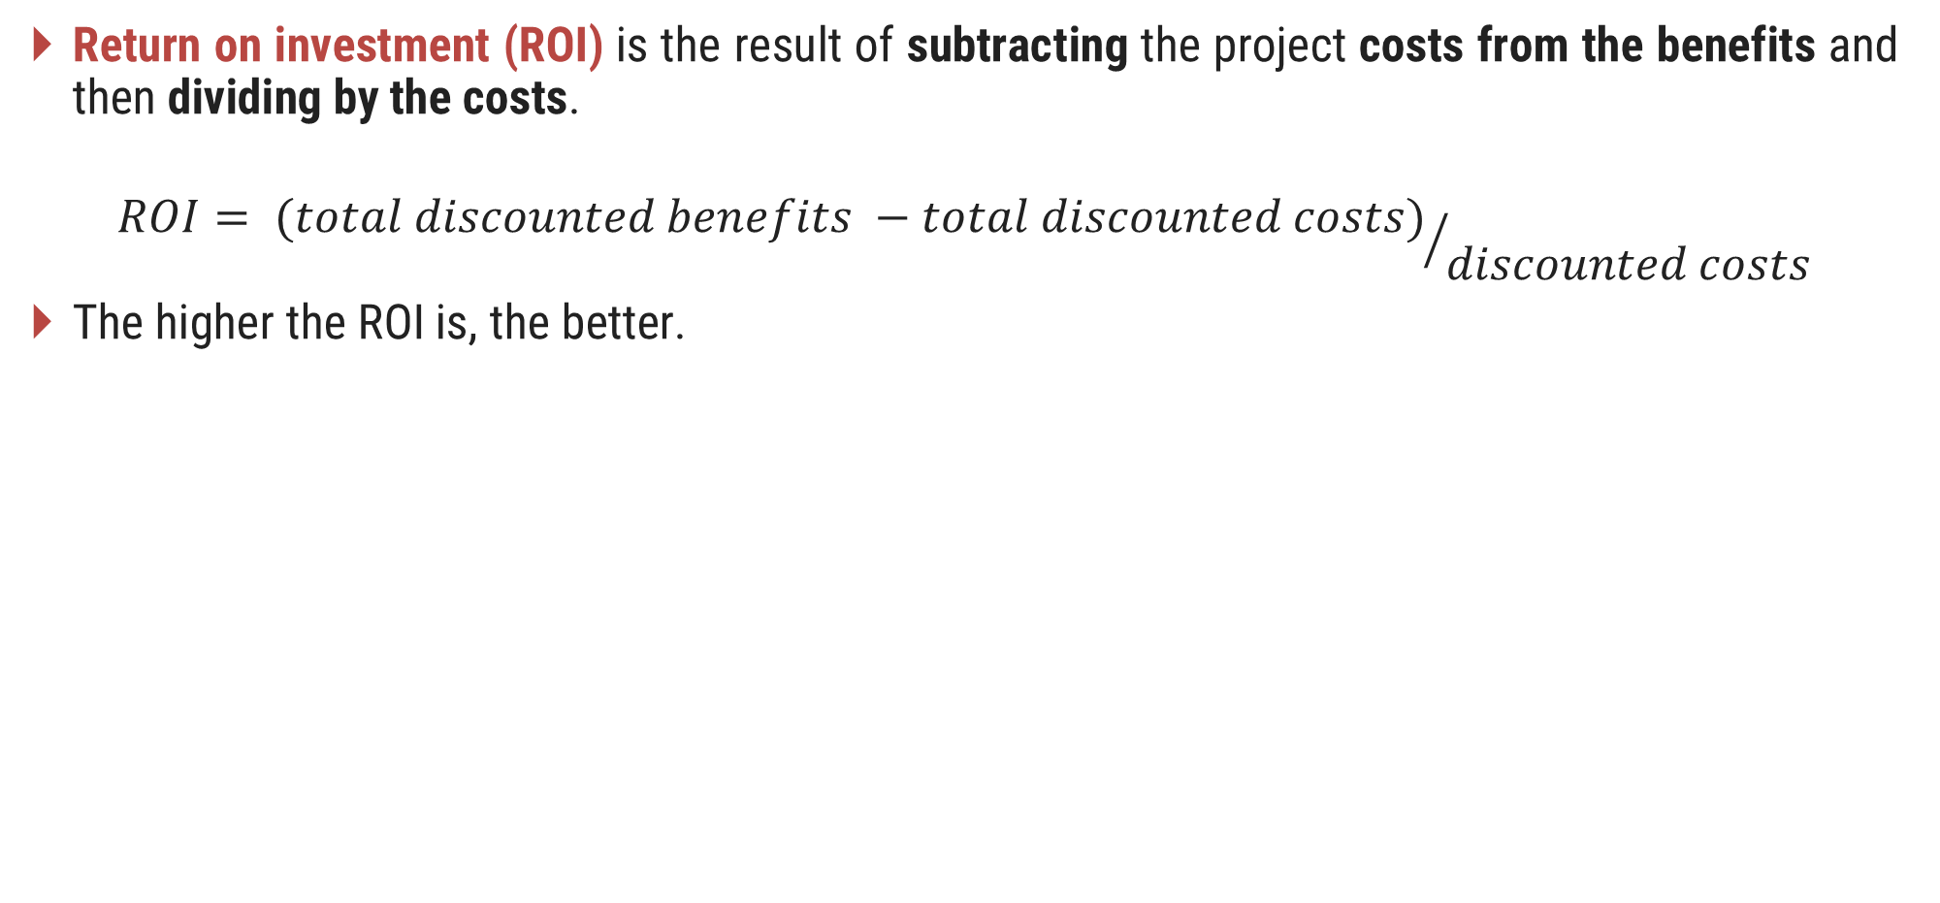
Return on Investment
Return on investment (ROI) is the result of subtracting the project costs from the benefits and then dividing by the costs.
$${ROI= (total discounted benefits −total discounted costs)}/{discounted costs}$$
The higher the ROI is, the better.

Slide 29
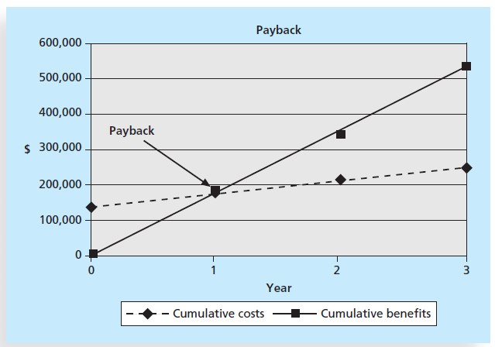
Payback Analysis
Payback period is the amount of time it will take to regain the total amount invested in a project, in terms of net cash inflows.
Payback analysis determines how much time will elapse before aggregated benefits overtake aggregated and continuing costs.
Payback occurs when the net cumulative benefits equal the net cumulative costs or when the net cumulative benefits minus costs equal zero.
Beyond this point, discounted benefits exceed discounted costs and the project shows a profit.
Early payback period is considered very good.

Slide 30
Exercise 1
Perform a financial analysis for a project using the format provided in earlier example. Assume that the projected costs and benefits for this project are spread over four years a follows: Estimated costs are $200,000 in Year 1 and $30,000 each year in Years 2, 3, and 4. Estimated benefits are $0 in Year 1 and $100,000 each year in Years 2, 3, and 4. Use a 9 percent discount rate, and round the discount factors to two decimal places. Create a spreadsheet or use the business case financials template on the companion website to calculate and clearly display the NPV, ROI, and year in which payback occurs. In addition, write a paragraph explaining whether you would recommend investing in this project, based on your financial analysis.

Slide 31
Exercise 2
Perform a financial analysis for a new software development project using a standard capital budgeting format. Use a 12 percent discount rate, and round the discount factors to two decimal places. Create a spreadsheet to calculate and clearly display the Net Present Value (NPV), Return on Investment (ROI), and the year in which payback occurs. In addition, write a paragraph explaining whether you would recommend investing in this project, based on your financial analysis. Assume that the projected costs and benefits for this project are spread over five years as follows:
Estimated costs:
Year 1: $150,000
Year 2: $25,000
Year 3: $25,000
Year 4: $30,000
Year 5: $20,000
Estimated benefits:
Year 1: $0
Year 2: $60,000
Year 3: $80,000
Year 4: $100,000
Year 5: $90,000

Slide 32
Exercise 3
Conduct a financial analysis for a new product launch, following a comprehensive capital budgeting methodology. Utilize an 8 percent discount rate, and round the discount factors to two decimal places. Create a spreadsheet to calculate and clearly display the Net Present Value (NPV), Return on Investment (ROI), and the year in which payback occurs. Furthermore, compose a paragraph outlining your recommendation on whether to proceed with this product launch, justified by your financial analysis. Assume that the projected costs and benefits for this new product are spread over four years as follows:
Estimated costs:
Year 1: $300,000
Year 2: $40,000
Year 3: $35,000
Year 4: $30,000
Estimated benefits:
Year 1: $0
Year 2: $120,000
Year 3: $180,000
Year 4: $150,000

Slide 33
Weighted Scoring Model
A weighted scoring model is a tool that provides a systematic process for selecting projects based on many criteria.
These criteria can include factors such as
Meeting broad organizational needs
Addressing problems, opportunities, or directives
The amount of time needed to complete the project
The overall priority of the project
Projected financial performance of the project
The first step in creating a weighted scoring model is to identify criteria that are important to the project selection process.

Slide 34
Weighted Scoring Model (contd.)
Possible criteria for IT projects include:
Supports key business objectives or strategies
Has strong internal sponsor
Has strong customer support
Uses realistic level of technology
Can be implemented in one year or less
Provides positive NPV
Has low risk in meeting scope, time, and cost goals
You assign a weight to each criterion based on its importance.
Determining weights requires consultation and final agreement.
You can assign weights based on percentages; the weights of the criteria must total 100 percent.
You can use a spreadsheet application to create a matrix of projects, criteria, weights, and scores.

Slide 35
Weighted Score Model Example
You can calculate weighted score for
Project 1 as:
25% * 90 + 15% * 70 + 15% * 50 + 10% * 25 + 5% * 20 + 20% * 50 + 10% * 20 = 56

Slide 36
Exercise 4
Create a weighted scoring model to determine grades for a course. Final grades are based on three exams worth 20 percent, 15 percent, and 25 percent, respectively; homework is worth 15 percent; and a group project is worth 25 percent. Enter scores for three students. Assume that Student 1 earns 100 percent on every item. Assume that Student 2 earns 70 percent on each of the exams, 80 percent on the homework, and 95 percent on the group project. Assume that Student 3 earns 90 percent on Exam 1, 80 percent on Exam 2, 75 percent on Exam 3, 80 percent on the homework, and 70 percent on the group project. You can use the weighted scoring model template, create your own spreadsheet, or make the matrix by hand.

Slide 37
Exercise 5
Create a weighted scoring model to evaluate potential business locations. The decision is based on the following criteria and their respective weights: Monthly Rent (25%), Condition (20%), Visibility (20%), Traffic (15%), Competition (10%), and Neighbors (10%). Evaluate five potential locations (Location1, Location2, Location3, Location4, Location5) by assigning a score from 1 to 10 for each criterion. The scores are as follows:
Criteria | Location 1 | Location 2 | Location 3 | Location 4 | Location 5
Monthly Rent | 3 | 3 | 5 | 2 | 8
Condition | 2 | 9 | 2 | 5 | 8
Visibility | 2 | 1 | 6 | 8 | 4
Traffic | 3 | 2 | 3 | 8 | 3
Competition | 4 | 3 | 4 | 5 | 6
Neighbour | 7 | 4 | 3 | 4 | 9

Slide 38
Implementing a Balanced Scorecard
A balanced scorecard is a strategic planning and management system that helps organizations align business activities to strategy, improve communications, and monitor performance against strategic goals.
The balanced scorecard transforms an organization’s strategic plan from an attractive but passive document into the ‘marching orders’ for the organization on a daily basis.
It provides a framework that not only provides performance measurements but helps planners identify what should be done and measured.
Sample scorecard

Slide 39
Developing a Project Charter
Section - 4

Slide 40
Developing a Project Charter
A project charter is a document that formally recognizes the existence of a project and provides direction on the project’s objectives and management.
It authorizes the project manager to use organizational resources to complete the project.
Key project stakeholders should sign a project charter to acknowledge agreement on the need for and intent of the project.
The PMBOK® Guide lists inputs, helpful in developing a project charter are:
A project statement of work describes the products or services to be created by the project team.
It usually includes a description of the business need for the project, a summary of the requirements and characteristics of the products or services, and organizational information.
A business case includes the project objective, high-level requirements, and time and cost goals.

Slide 41
Developing a Project Charter (contd.)
Agreements include much of the information needed for creating a good project charter.
Some people might use a contract or agreement in place of a charter.
Enterprise environmental factors include relevant government or industry standards, the organization’s infrastructure.
Organizational process assets include formal and informal plans, policies, procedures, guidelines, information systems, financial systems, management systems, lessons learned, and historical information that can influence a project’s success.
Experts from inside and outside the organization should be consulted when creating a project charter to make sure it is useful and realistic.

Slide 42
Tools & Technique for Developing a Project Charter
The main tools and techniques for developing a project charter are
Expert judgment and facilitation techniques, such as brainstorming and meeting management.
Experts from inside and outside the organization should be consulted when creating a project charter to make sure it is useful and realistic.

Slide 43
Project Charter
Project Charter should include at least the following basic information:
The project’s title and date of authorization
The project manager’s name and contact information
A summary schedule, including the planned start and finish dates; if a summary milestone schedule is available, it should also be included or referenced
A summary of the project’s budget or reference to budgetary documents
A brief description of the project objectives, including the business need or other justification for authorizing the project
Project success criteria, including project approval requirements and who signs off on the project
A summary of the planned approach for managing the project, which should describe stakeholder needs and expectations, important assumptions, and constraints, and should refer to related documents, such as a communications management plan
A roles and responsibilities matrix
A sign-off section for signatures of key project stakeholders
A comments section in which stakeholders can provide important comments related to the project
Sample Project Charter | Single Page Project Charter

Slide 44
Developing a Project Management Plan
Section - 5

Slide 45
Developing a Project Management Plan
A project management plan is a document used to coordinate all project planning documents and help guide a project’s execution and control.
It documents
Project planning assumptions and decisions regarding choices
Help communication among stakeholders
Define the content, scope, and timing of key management reviews
Provide a baseline for progress measurement and project control
It should be dynamic, flexible, and subject to change when the environment or project changes.
It should greatly assist the project manager in leading the project team and assessing project status.
The main inputs for developing a project management plan include the project charter, outputs from planning processes, enterprise environment factors, and organizational process assets.
The main tool and technique is expert judgment, and the output is a project management plan.

Slide 46
Project Management Plan Contents
A project management plan includes an
Introduction or overview of the project
A description of how the project is organized
The management and technical processes used on the project, and
Sections describing the work to be performed, the schedule, and the budget
A small project involving few people have a project management plan consisting of a project charter, scope statement, and Gantt chart.
A large project involving 100 people working over three years would have a detailed project management plan.

Slide 47







Overview of the Project
Project Name
Sponsor Name
Project Deliverables
Definition and Acronyms
Project Description and
the need it addresses
Project Manager and
Key Team Members
Reference Materials

Slide 48



Description of the Project
01
02
03
Organizational
Charts
Project
Responsibilities
Process-related
Information
Shows the lines of authority, responsibilities, and communication for the project.
Shows major project functions and activities and identify the people responsible.
Documents major processes to follow on the project.

Slide 49






Management and Technical Approaches
Management Objectives
Project Priorities, Assumptions or constraints
Project Controls
Monitor project progress and handle changes
Risk management
Identify, manage, and control risks
Project Staffing
Number and types of people required
Technical Processes
Project methodologies and documenting information

Slide 50
Scope, Schedule and Budget Information
The scope management plan summarizes the following:
Major work packages: A project manager usually organizes the project work into several work packages using a work breakdown structure (WBS).
Key deliverables: This section lists and describes the key products created as part of the project. It should also describe the quality expectations for the product deliverables.
Other work-related information: It might list specific hardware or software to use on the project or certain specifications to follow.
Schedule Information section include the followings:
Summary schedule provides one-page summary of the overall project schedule. It might list only key deliverables and their planned completion dates using Gantt chart.
Detailed schedule provides more detailed information about the project schedule. It should reference the schedule management plan and discuss dependencies among project activities that could affect the project schedule.
The summary budget includes the total estimate of the overall project’s budget.
It could also include the budget estimate for each month or year by certain budget categories.
Detailed budget section summarizes the contents of the cost management plan and includes
more detailed budget information.

Slide 51
Monitoring and Controlling a Project Work
Section - 6

Slide 52
Monitoring and Controlling
Monitoring project work includes collecting, measuring, and distributing performance information.
It also involves calculating measurements and evaluating trends to determine what process improvements can be made.
The project team should continuously monitor project performance to assess the overall health of the project and identify areas that require special attention.
Important inputs for monitoring and controlling project work are
The project management plan
Schedule and cost forecasts
Validated changes
Work performance information
Enterprise environmental factors
Organizational process assets

Slide 53
Monitoring and Controlling – contd.
The project management plan provides the baseline for identifying and controlling project changes.
A baseline is the approved project management plan plus approved changes.
The project management plan includes a section that describes the work to perform on a project.
It describes the key deliverables for the project, the products of the project, and quality requirements.
The schedule section of the project management plan lists the planned dates for completing key deliverables, and the budget section of the plan provides the planned cost of these deliverables.
If the project team or someone else causes changes during project execution, the team must revise the project management plan and have it approved by the project sponsor.
Schedule and cost forecasts, validated changes, and work performance information provide details on how project execution is going.

Slide 54
Monitoring and Controlling – contd.
Important outputs of monitoring and controlling project work include change requests and work performance reports.
Change requests include recommended corrective and preventive actions and defect repairs.
Corrective actions should result in improvements in project performance. E.g., if project team members have not been reporting hours that they worked, a corrective action would show them how to enter the information and let them know that they need to do it.
Preventive actions reduce the probability of negative consequences associated with project risks. E.g., modifying a time tracking system screen to avoid common errors people have made in the past.
Defect repairs involve bringing defective deliverables into agreement with requirements. E.g., having someone redo an incorrect entry.
Work performance reports include status reports, progress reports, and other documents used to communicate performance.

Slide 55
Performing Integrated Change Control
Section - 7

Slide 56
Integrated Change Control
Integrated change control involves identifying, evaluating, and managing changes throughout the project life cycle.
The three main objectives of integrated change control are:
Prompting the factors that create changes to ensure that changes are beneficial: Project managers and the teams must make trade-offs among key project dimensions, such as scope, time, cost, and quality.
Determining that a change has occurred: Know the status of key project areas at all times. Project manager must communicate significant changes to top management and key stakeholders.
Managing actual changes as they occur: Exercise discipline in managing the project to help minimize the number of changes that occur.
Change requests can be oral or written, formal or informal.
Change is unavoidable. Stakeholders should be open to making major changes in the project.

Slide 57
Change Control System
A change control system is a formal, documented process that describes when and how official project documents may be changed.
It also describes the people authorized to make changes, the paperwork required for these changes, and any automated or manual tracking systems the project will use.
A change control system often includes a change control board (CCB), configuration management, and a process for communicating changes.
A change control board (CCB) is a formal group of people responsible for approving or rejecting changes to a project.
The primary functions of a CCB are to provide guidelines for preparing change requests, evaluating change requests, and managing the implementation of approved changes.
Drawbacks: The time it takes to make decisions on proposed changes.
Configuration management ensures that the descriptions of the project’s products are correct and complete.
It involves identifying and controlling the functional and physical design characteristics of products and their support documentation.

Slide 58
Suggestions for performing integrated change control
Suggestions for performing integrated change control
View project management as a process of constant communication and negotiation
Plan for change
Establish a formal change control system, including a change control board (CCB)
Use effective configuration management
Define procedures for making timely decisions about smaller changes
Use written and oral performance reports to help identify and manage change
Use project management software and other software to help manage and communicate changes
Focus on leading the project team and meeting overall project goals and expectations

Slide 59
Quiz
Section - 7

Slide 60
Quiz
Which of the following processes is not part of project integration management?
developing the project business case
developing the project charter
developing the project management plan
closing the project or phase
What is the last step in the four-stage planning process for selecting IT projects?
IT strategy planning
business area analysis
mind mapping
resource allocation
Which of the following is not a best practice for new product development projects?
aligning projects and resources with business strategy
selecting projects that will take less than two years to provide payback
focusing on customer needs in identifying projects
assigning project managers to lead projects

Slide 61
Quiz (contd.)
A new government law requires an organization to report data in a new way. Which of the following categories would include a new information system project to provide this data?
problem
opportunity
directive
regulation
If estimates for total discounted benefits for a project are $120,000 and total discounted costs are $100,000, what is the estimated return on investment (ROI)?
$20,000
$120,000
20 percent
120 percent

Slide 62
Quiz (contd.)
A _____ is a document that formally recognizes the existence of a project and provides direction on the project's objectives and management.
project charter
contract
business case
project management plan
Which of the following items is not normally included in a project charter?
the name of the project manager
budget information
stakeholder signatures
a Gantt chart
______ ensures that the descriptions of the project's products are correct and complete.
Configuration management
Integrated change control
Integration management
A change control board

Slide 63
Quiz (contd.)
Which of the following is not a suggestion for performing integrated change control?
use good configuration management
minimize change
establish a formal change control system
view project management as a process of constant communication and negotiation
What tool and technique is used for all processes of project integration management?
project management software
templates
expert judgement
all of the above

Slide 64
Thank You

